Slide 1

CONVERSATIONS
@aSodaMachine2.0
ALISON LEWIS
October 19, 2011

Slide 2
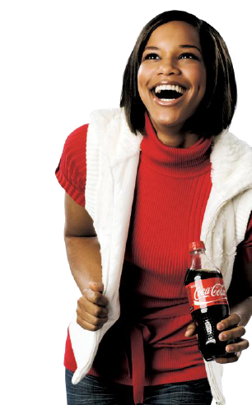
FROM 9 DRINKS A DAY
TO 1.7 BILLION
SERVINGS A DAY
AND 20 MILLION
CUSTOMERS A WEEK
IN 125 YEARS

Slide 3
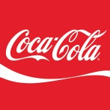

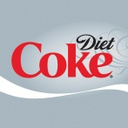

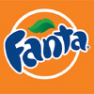











500 BRANDS
800 LOW/NO-CALORIE
3,500 PRODUCTS
$15 BILLION
BRANDS

Slide 4
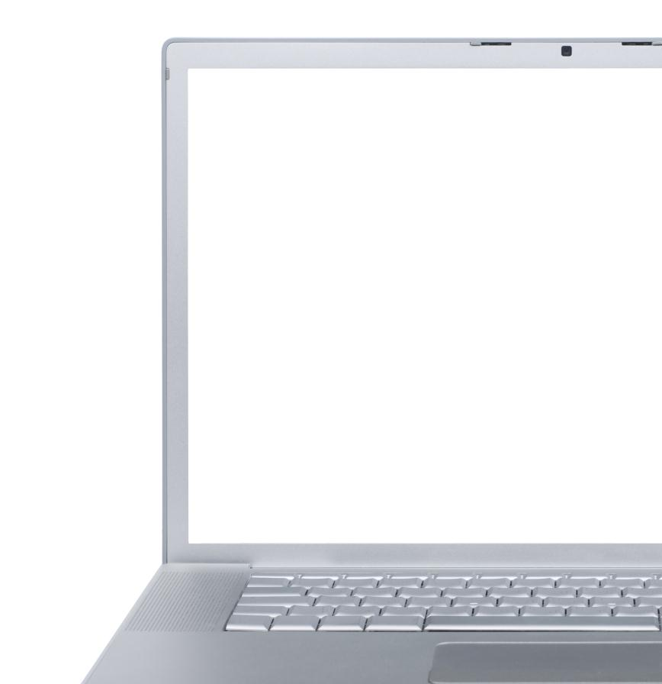


35MM
FANS
> 17+MM
MEMBERS
LEVERAGING EXPRESSIONS TO CULTIVATE CONVERSATIONS…
THROUGH INNOVATION

Slide 5
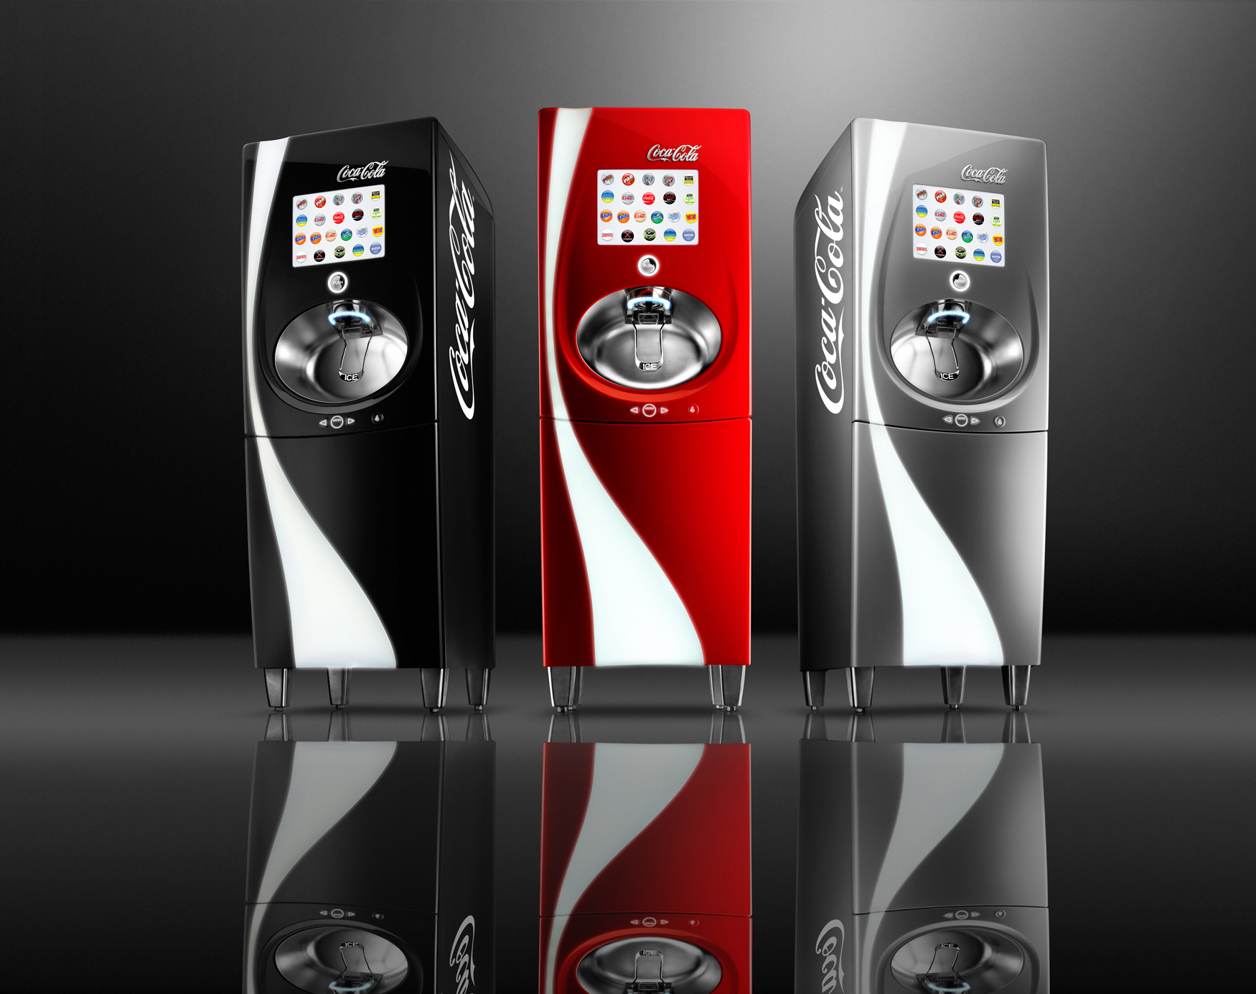
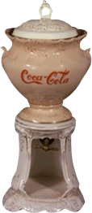
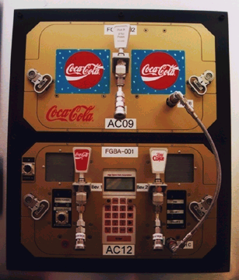
1896
1991
FIRST COCA-COLA DISPENSER
SPACE SHUTTLE
DISCOVERY

Slide 6
GAME CHANGING INNOVATION

Slide 7
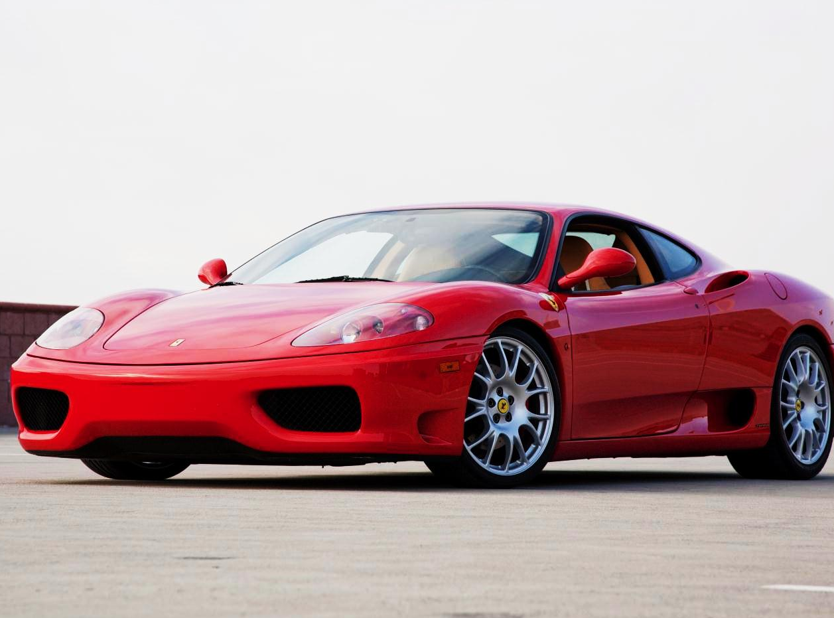
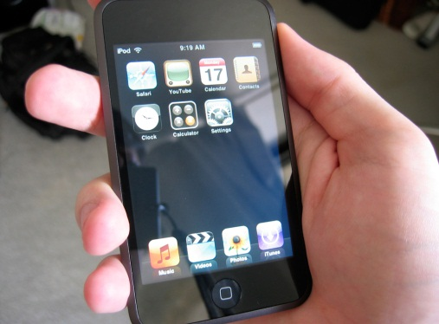
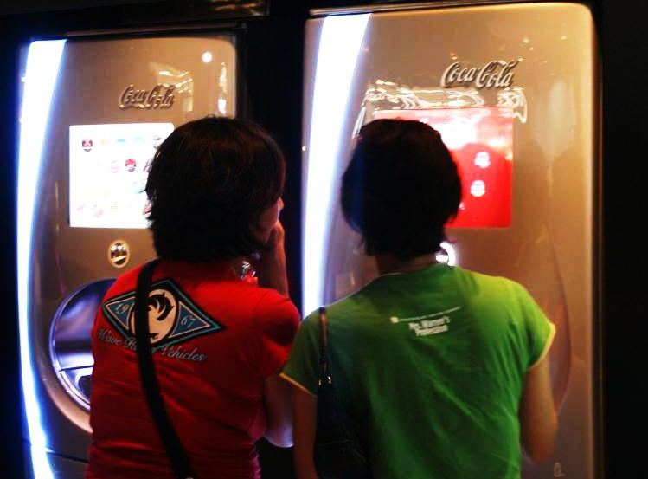
COOL,
PROPRIETARY DESIGN
ABUNDANT CHOICE
IN A SMALL PLACE
FUN, PERSONALIZED
BRANDED USER EXPERIENCE

Slide 8
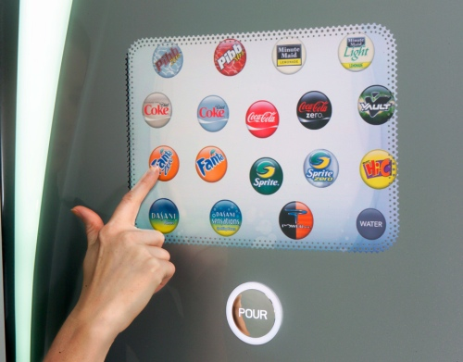
BEYOND
A DISPENSING ASSET
TO A CONNECTION MACHINE
TO A
CONSUMER
ENGAGEMENT PLATFORM

Slide 9
INTERNET
CONNECTIVITY

Slide 10
0100101001001010101010010010101010101010010101010101001010101101010101010101010100101010101000100101100101001010001001010010101010010101001010100
TRANSACTION DATA

Slide 11
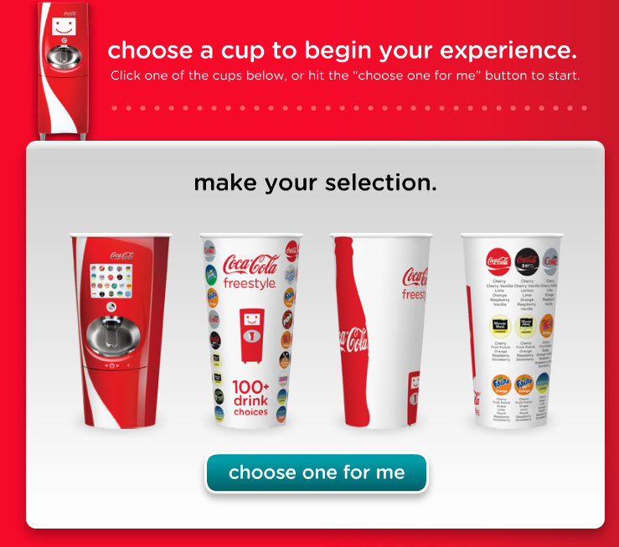
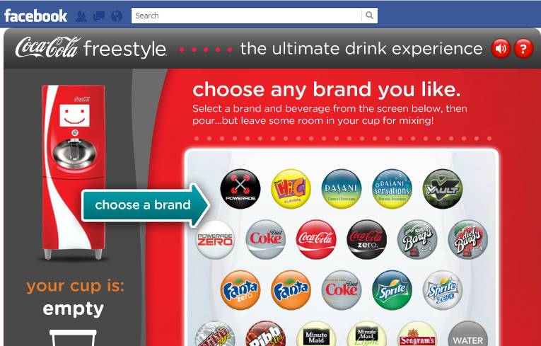
CHOOSE YOUR EXPERIENCE…
CREATE YOUR DRINK

Slide 12
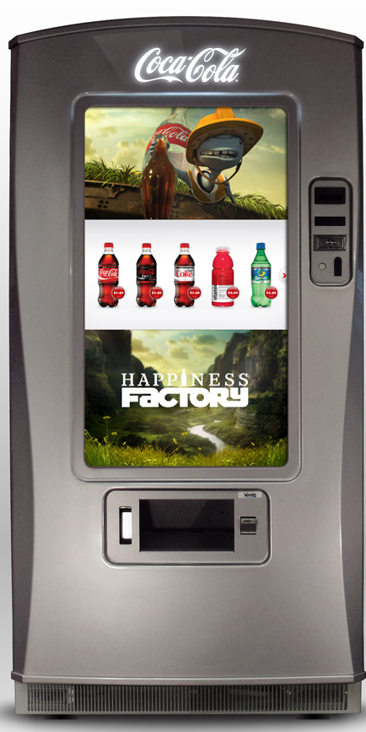
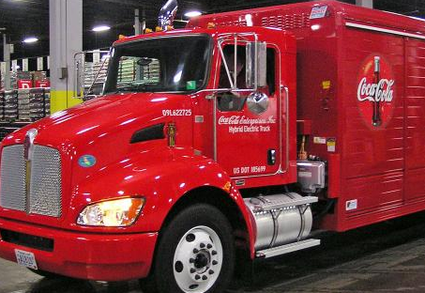
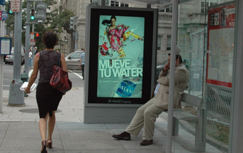
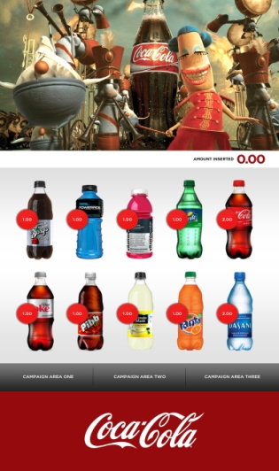
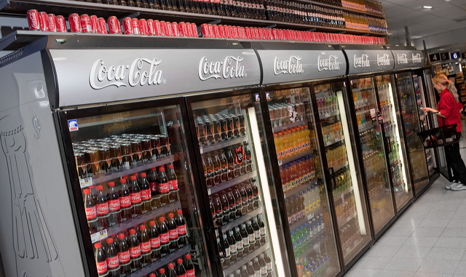
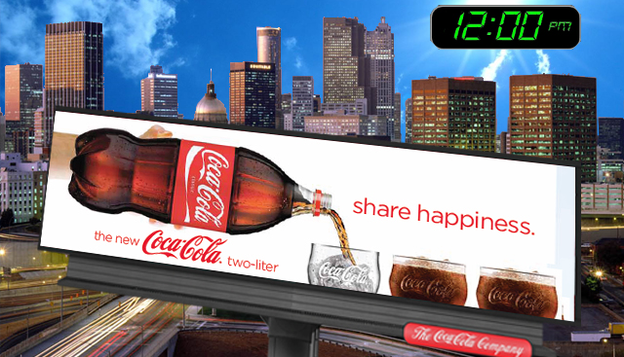
IMAGINE IF YOU WILL….

Slide 13
VIDEO

Slide 14
THANK YOU

